Slide 1
Complex Social Systems: THE BEHAVIOURAL SINK
CSS Project’s Presentation - Alessio Melone, Henrique Ranieri, Francesco Rosano
Materials may not be shared without previous written permission of the authors and DH

Slide 2
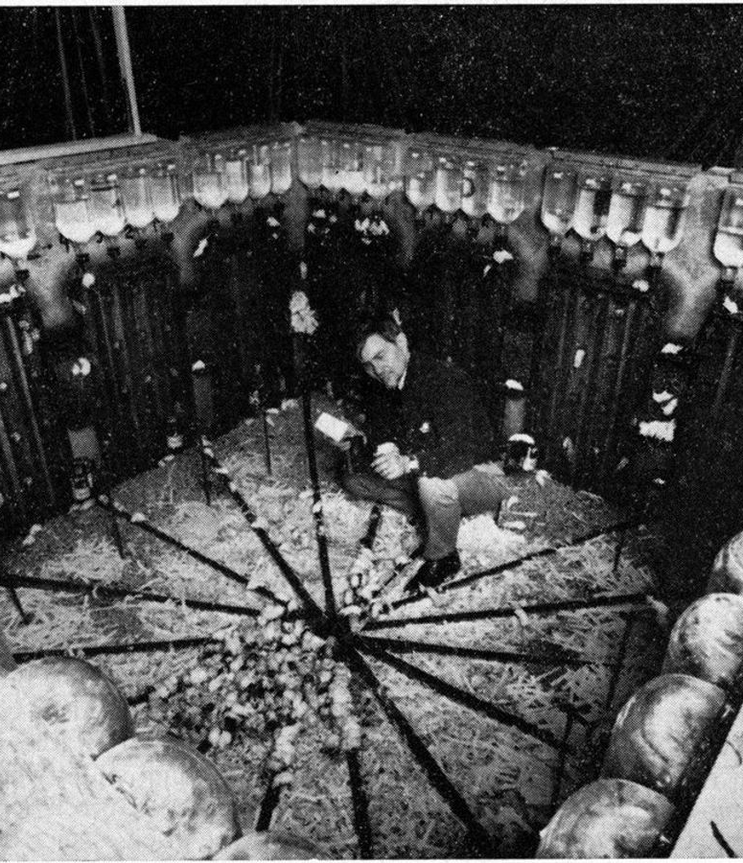
Universe 25 Experiment – John B. Calhoun, 1968
SETTING
Four mice couples at t₀
«Rat Utopia»:
Unlimited food and water
Protection from predators
Protection from weather
Protection from external diseases
Four pens in a «U» shape, one food dispenser each
Habitat built for 4000 mice
Only one scarce resourse: space
Notes:
The experiment was designed to eliminate all the possible external factors that could lead to a decrease in popolation (REFER TO THE SLIDE). The only limited resource was space, in particular it was interesting to see how overcrowding affects social behaviours.

Slide 3
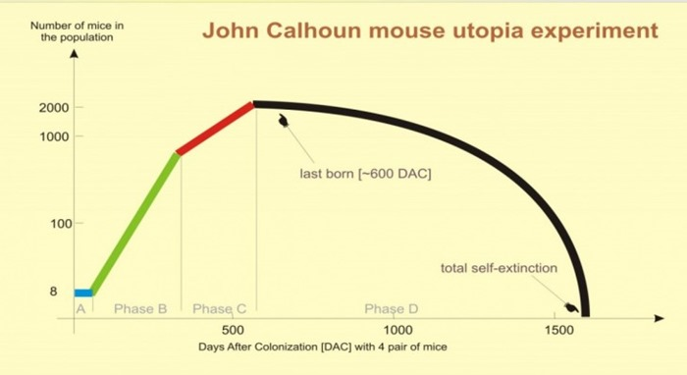
Universe 25 Experiment – John B. Calhoun, 1968
EMERGING BEHAVIOURS
Population peaked at 2200 mice (habitat for 4000)
Antisocial emerging behaviour:
Mothers abandoning «mothership», infant mortality
Cannibalism
Increased aggresivity
Sexual deviation
Self-isolation/«togetherness» necessity
Hyperactivity/laziness
Strict social hierarchy
High density lead to extinction
"BEHAVIOURAL SINK"
Too many complex emerging behaviours for a single model?
Notes:
(REFER TO THE SLIDES) +
In Calhoun's experiment, as the mouse population faced severe stress from overcrowding, three distinct behavioral groups emerged.
The first group consisted of the weakest and socially rejected mice, who lived a passive life interspersed with occasional self-harm.
The second group was composed of females who isolated themselves in higher nests.
The third group, called "the beautiful ones," remained completely aloof from social strife, focusing only on self-care and basic needs without engaging in reproduction or aggressive behaviors.
This isolation was justified by Calhoun as the inequality between the number of mice and the number of social roles: there were too many mice and not enough social roles.

Slide 4
Universe 25 Experiment – John B. Calhoun, 1968
EMERGING BEHAVIOURS:
Population peaked at 2200 mice (habitat for 4000)
Antisocial emerging behaviour:
Mothers abandoning «mothership», infant mortality
Cannibalism
Increased aggresivity
Sexual deviation
Self-isolation/«togetherness» necessity
Hyperactivity/laziness
Strict social hierarchy
High density lead to extinction
"BEHAVIOURAL SINK"
OUR FOCUS:
Explored using 3 different agent-based models
Notes:
(REFER TO THE SLIDES) +
In Calhoun's experiment, as the mouse population faced severe stress from overcrowding, three distinct behavioral groups emerged.
The first group consisted of the weakest and socially rejected mice, who lived a passive life interspersed with occasional self-harm.
The second group was composed of females who isolated themselves in higher nests.
The third group, called "the beautiful ones," remained completely aloof from social strife, focusing only on self-care and basic needs without engaging in reproduction or aggressive behaviors.
This isolation was justified by Calhoun as the inequality between the number of mice and the number of social roles: there were too many mice and not enough social roles.

Slide 5
Agenda
Models
1. Social togetherness
2. Social Dominance and Fights
3. Infant Mortality and Mothership

Slide 6
1. Social togetherness
Speaker: Henrique Ranieri

Slide 7
«Gradually the social aspect of the activity (of eating - editor’s note) became determinant: the rats would rarely eat except at hopper already in use by other animals.
…
the same pathological "togetherness"
tended to disrupt the ordered sequences
of activity involved in other vital modes
of behavior such as the courting of sex
partners, the building of nests and the
nursing and care of the young
Population Density and Social Pathology,
John B. Calhoun
https://gwern.net/doc/sociology/1962-calhoun.pdf

Slide 8
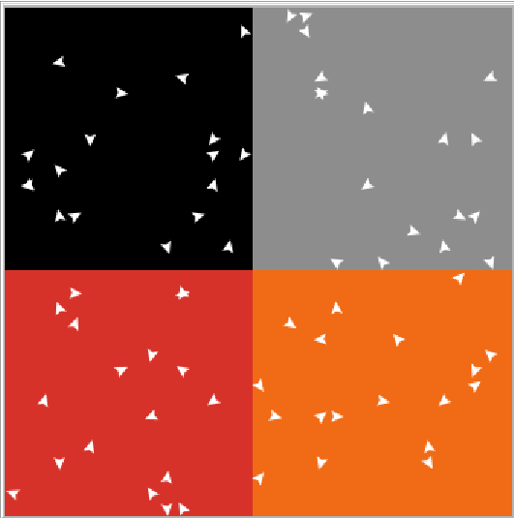
Social togetherness - Model
Focus: ’’Eating and other biological activities were thereby transformed into social activities in which the principal satisfaction was interaction with other rats.’’
Environment:
Four rooms with three bridges in between.
Agent behaviour:
Each rat tries to feed on a unique feeding window. Fixed size, random interval.
Prioritize adjancent rooms that meet their social togetherness necessities.
Social togetherness dynamically changes with the amount of rats each specific rat ate with. Eating with more rats conditions the rat to seek more social togetherness.
Generational dynamic: Rats die and new ones are born. Always constant population size.
https://gwern.net/doc/sociology/1962-calhoun.pdf

Slide 9
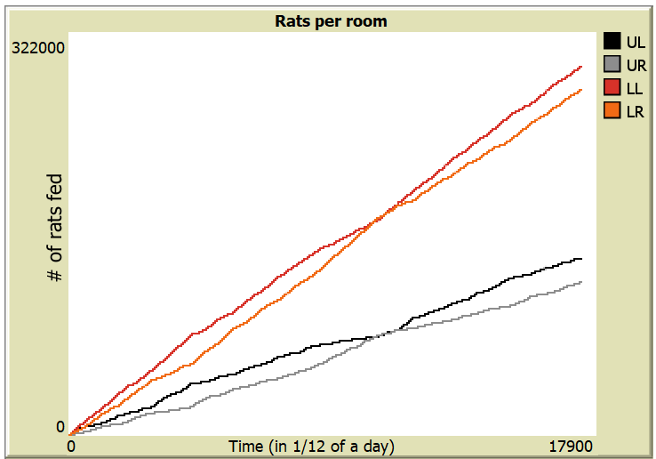
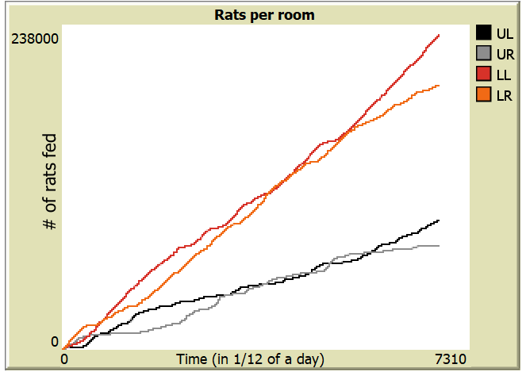
Social Togetherness - Population distribution
Lower rooms are consistently more populated.
Total room population emerges in vertical pairs.
Self-reinforcing social hub.

Slide 10
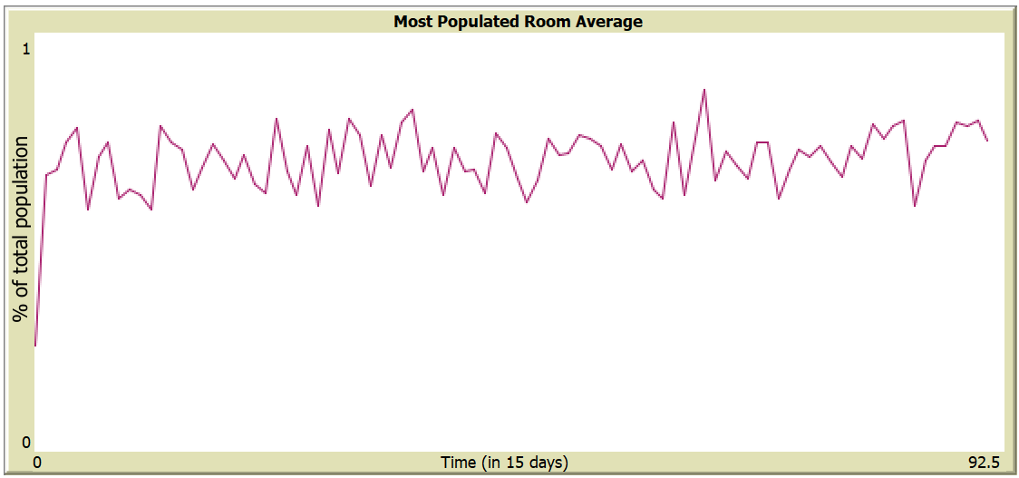
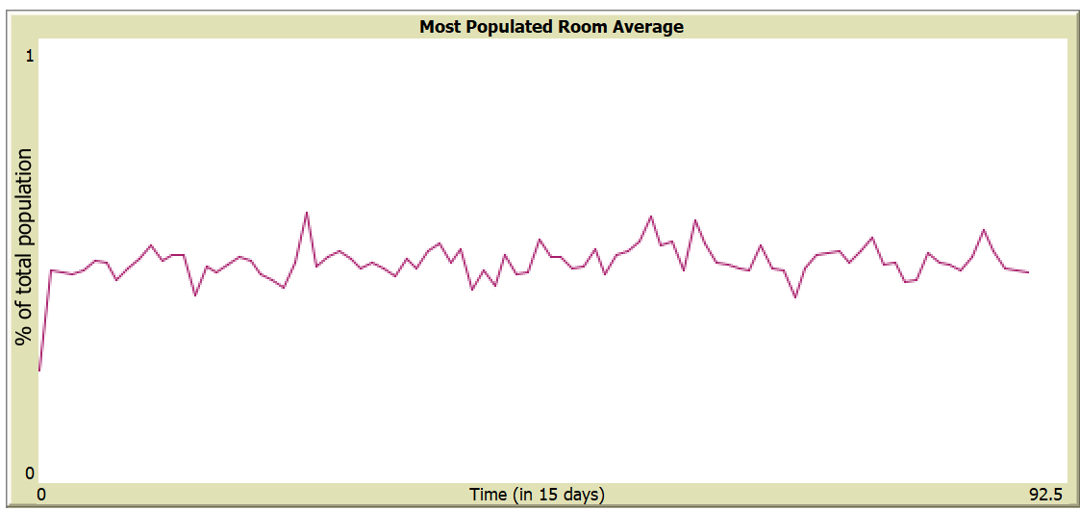
Social Togetherness - Beneficial enviroment conditions
The ease of environmental conditions allows social behaviours to thrive, leading to clustering.
More flexible feeding time.
More food available.
feeding windows of size 90% of the day
feeding windows of size 25% of the day

Slide 11
Social Togetherness - Additional observed behaviors
New generations have little influence over an established environment.
Conditioning coefficient values become irrelevant over time.

Slide 12
2. Social Dominance and Fights
Speaker: Alessio Melone

Slide 13
«… a dominant male was usually able to expel all other males and possess a harem of females.
The sex ratio approximated equality only in those groups that fell within the expected size range.
In the larger groups, on the other hand, there were many more males than females.
…
The more fights a male initiated and the
more fights he won, the more likely he
was to establish a position of dominance.
Population Density and Social Pathology,
John B. Calhoun
https://gwern.net/doc/sociology/1962-calhoun.pdf

Slide 14

Social dominance and fights

Slide 15
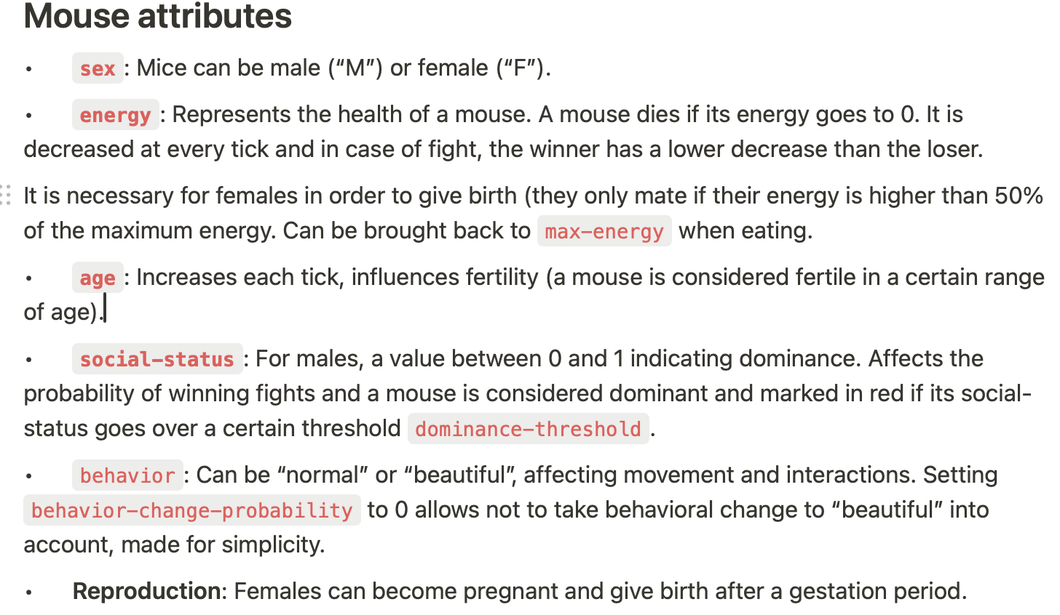
Social dominance and fights – Mouse attributes

Slide 16
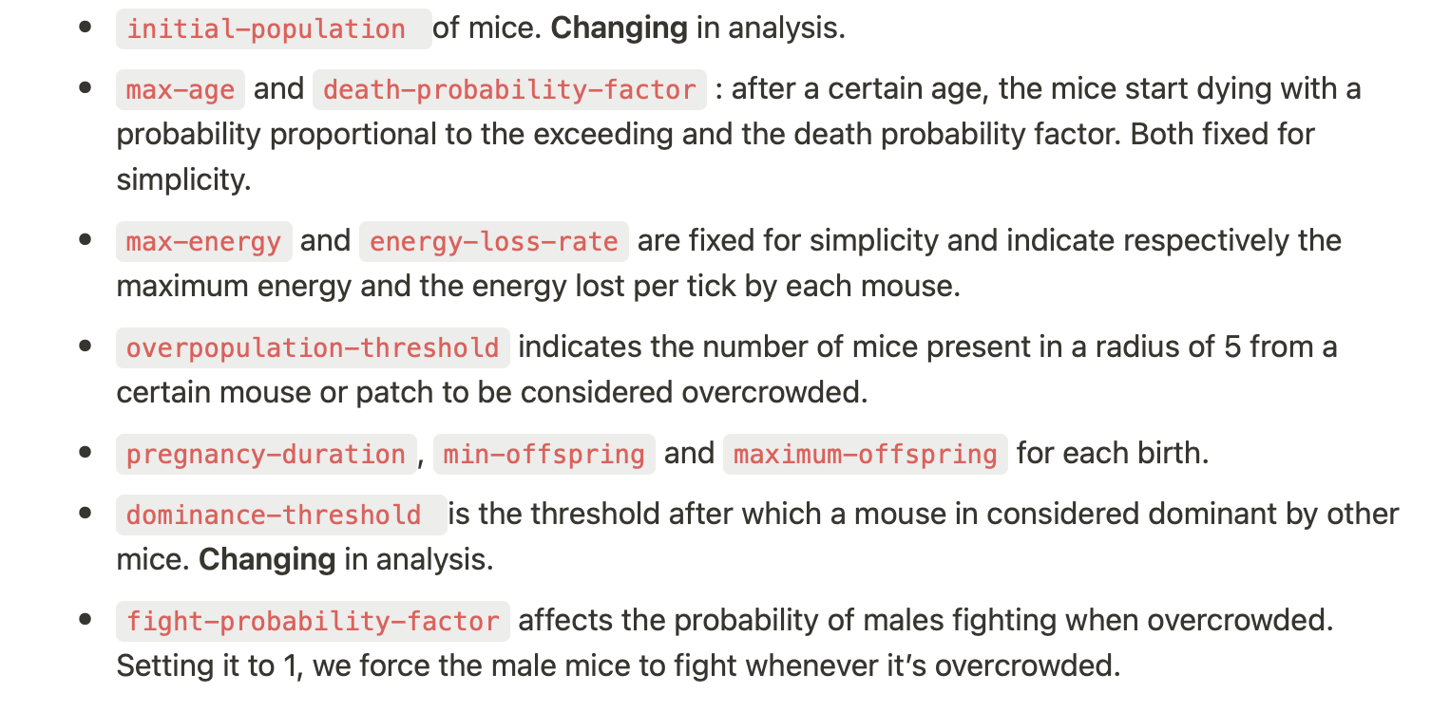
Social dominance and fights – Model parameters

Slide 17
Social dominance and fights – Moving
Seeking Food:
• Dominant Males: Claim and hover around a dispenser.
• Non-Dominant Males: Avoid dispensers near dominant males.
• Females: Go to the nearest dispenser.
Seeking Mates: appx. 5 attempts per lifespan.
• Dominant Males: Avoid mating if stronger males are nearby.
• Non-Dominant Males: Avoid females near dominant males.
Random Movement: Bias towards the center when idle.

Slide 18
Social dominance and fights – Mating and fighting
Fighting
• Happens among males under overcrowded conditions.
• Outcomes depend on social status and energy; can lead to death.
Reproducing
• Fertile females reproduce based on energy and overcrowding.
• After gestation, they give birth to a random number of offspring.

Slide 19
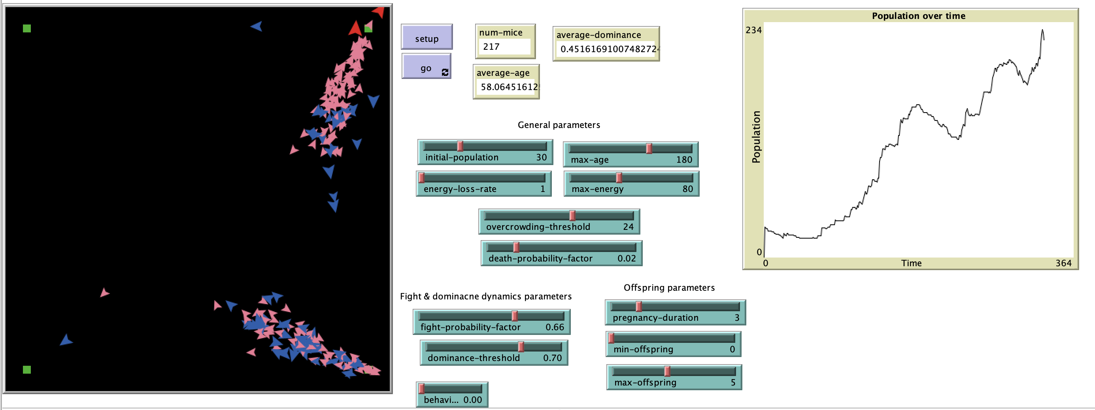
Social dominance and fights – Clustering

Slide 20
Social dominance and fights – Clustering

Slide 21
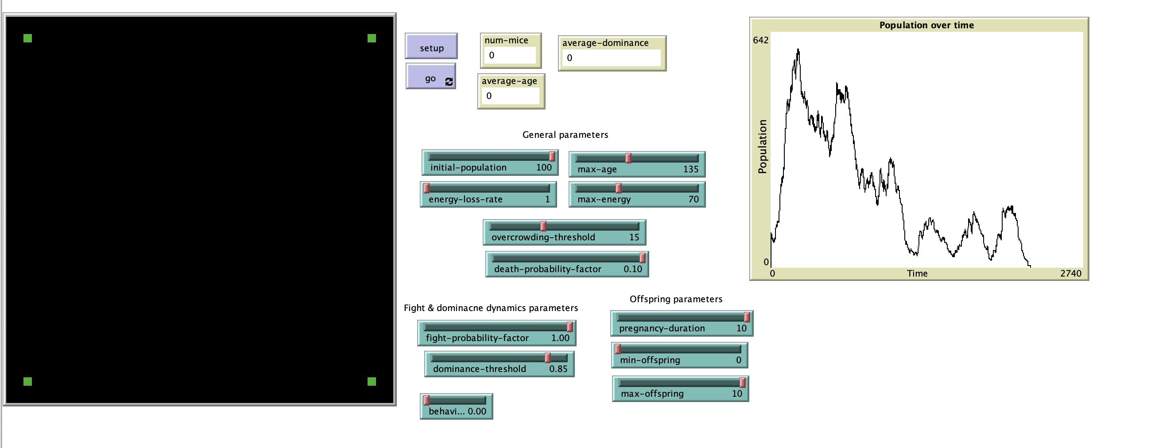
Social dominance and fights – 100 initial population

Slide 22
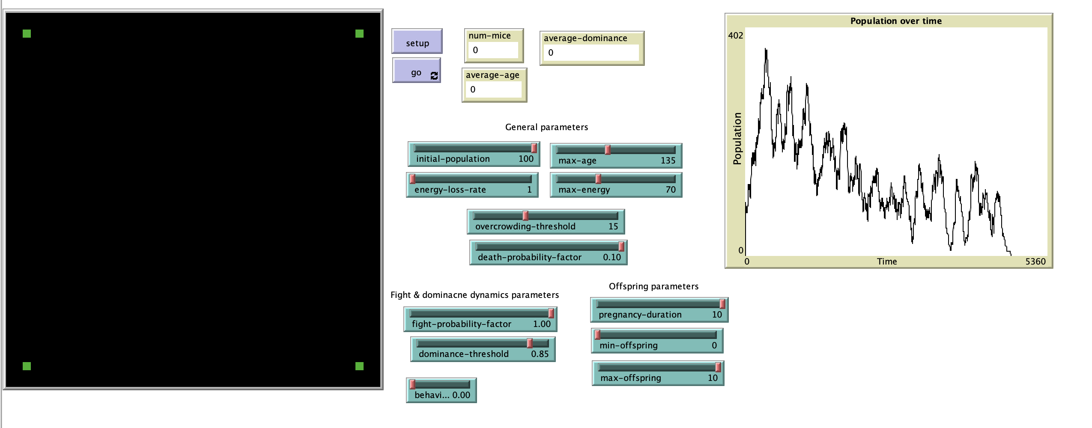
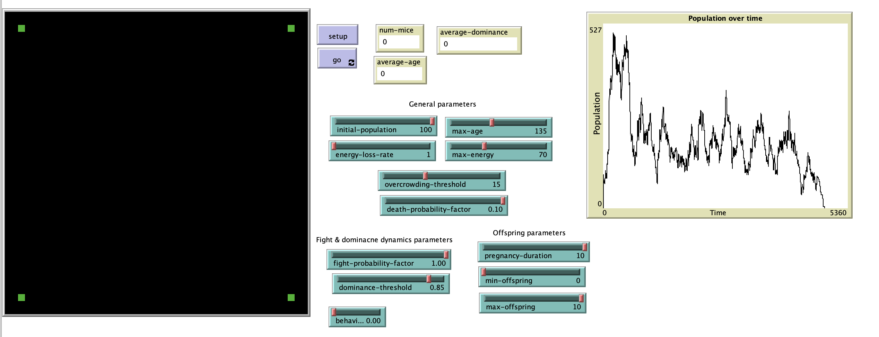
Social dominance and fights – 100 initial population

Slide 23
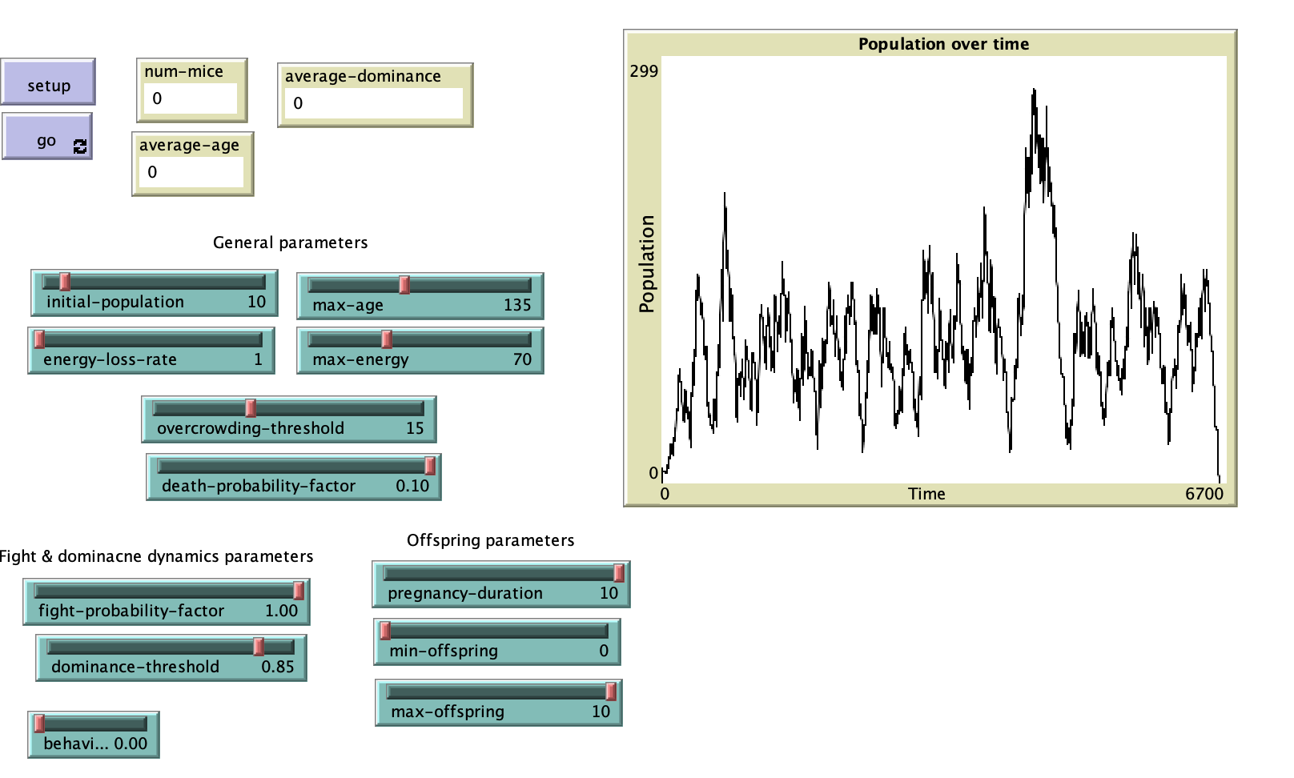
Social dominance and fights – 10 initial population

Slide 24
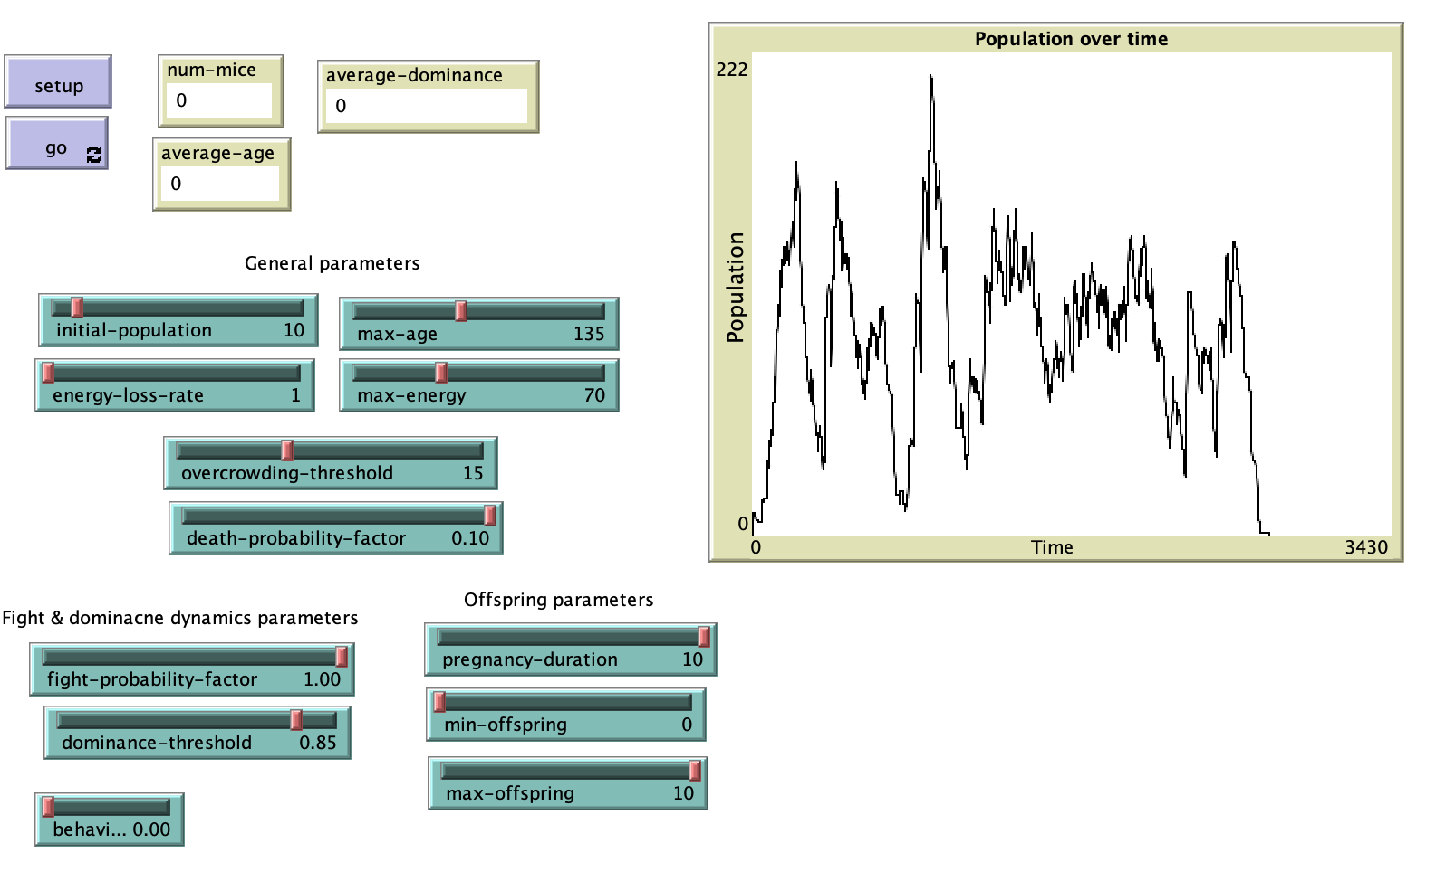
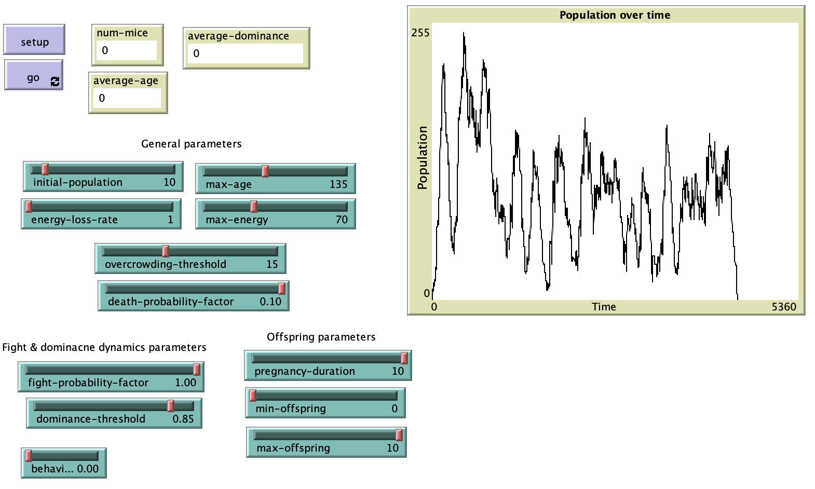
Social dominance and fights – 10 initial population

Slide 25
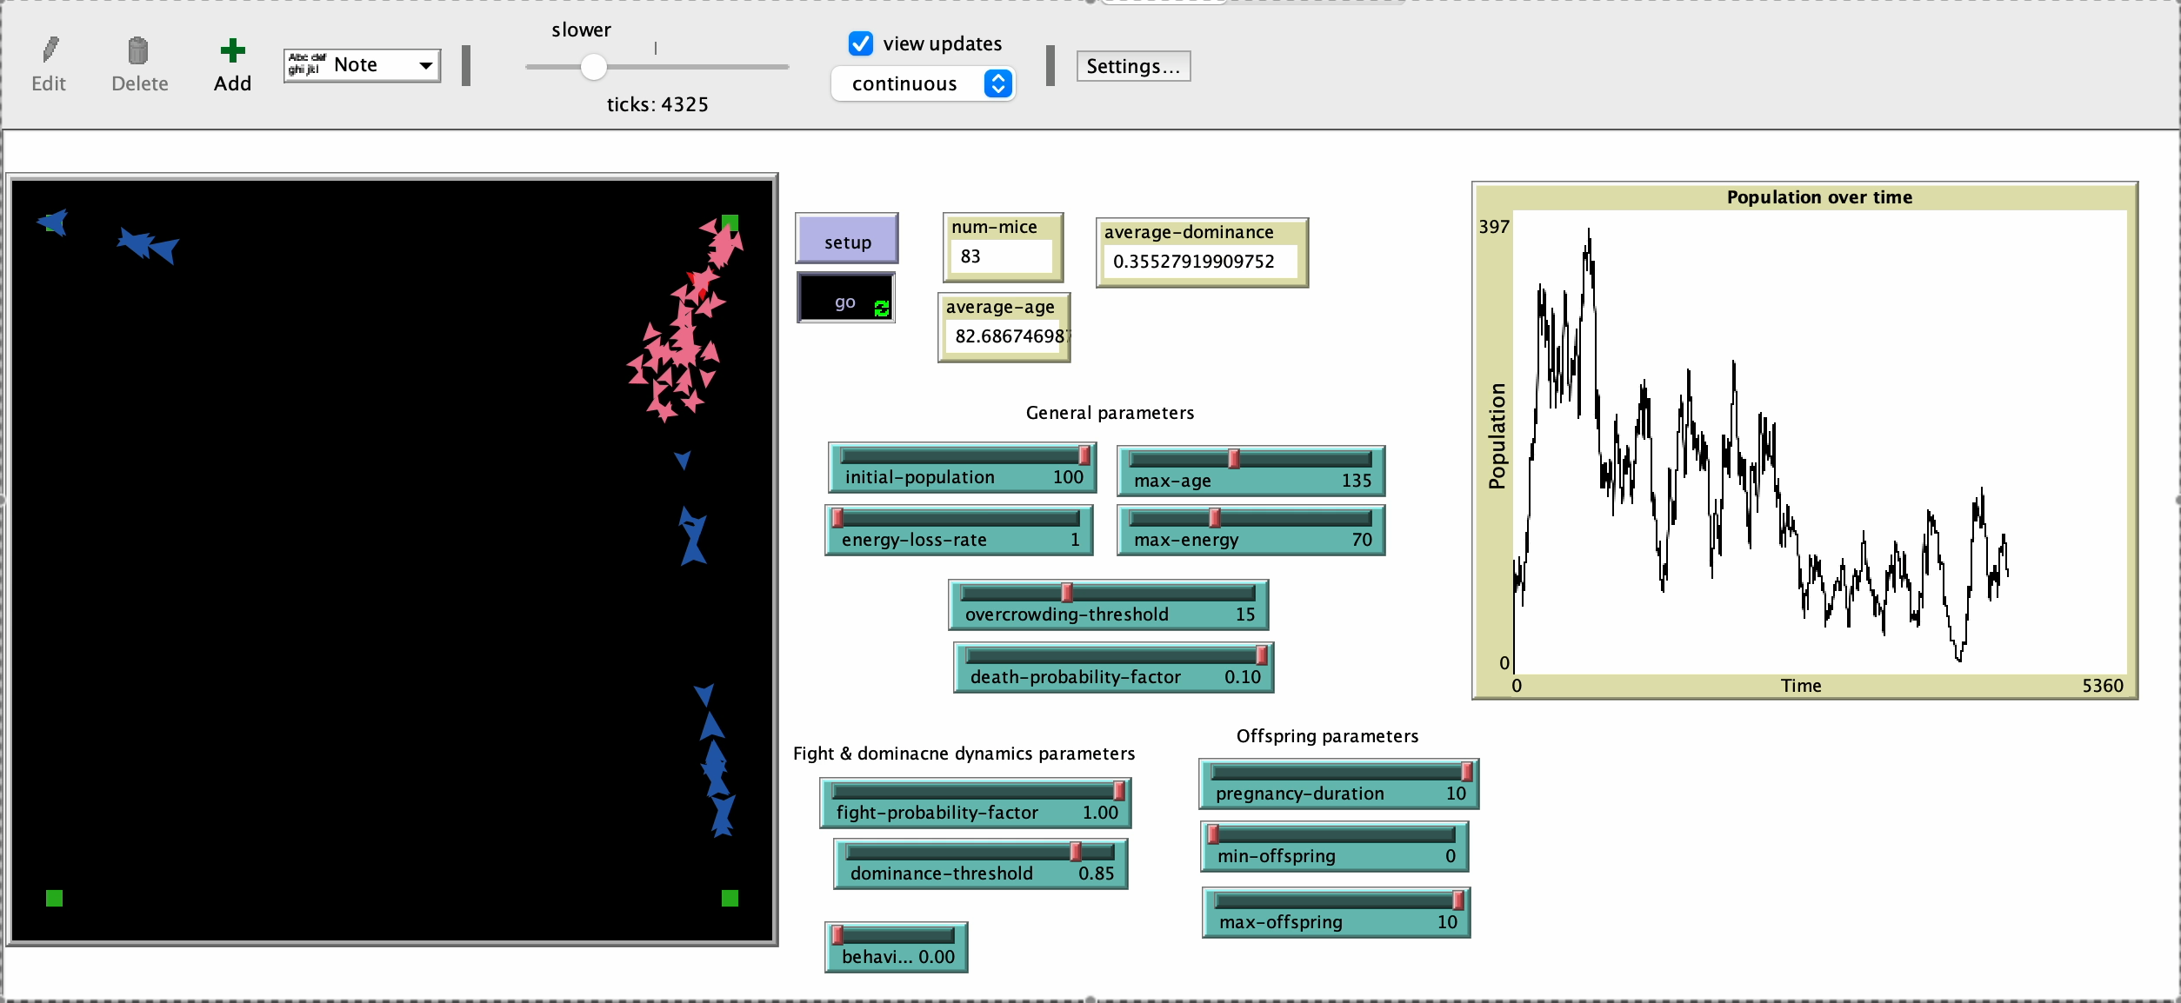
Social dominance and fights – Why extinction?

Slide 26
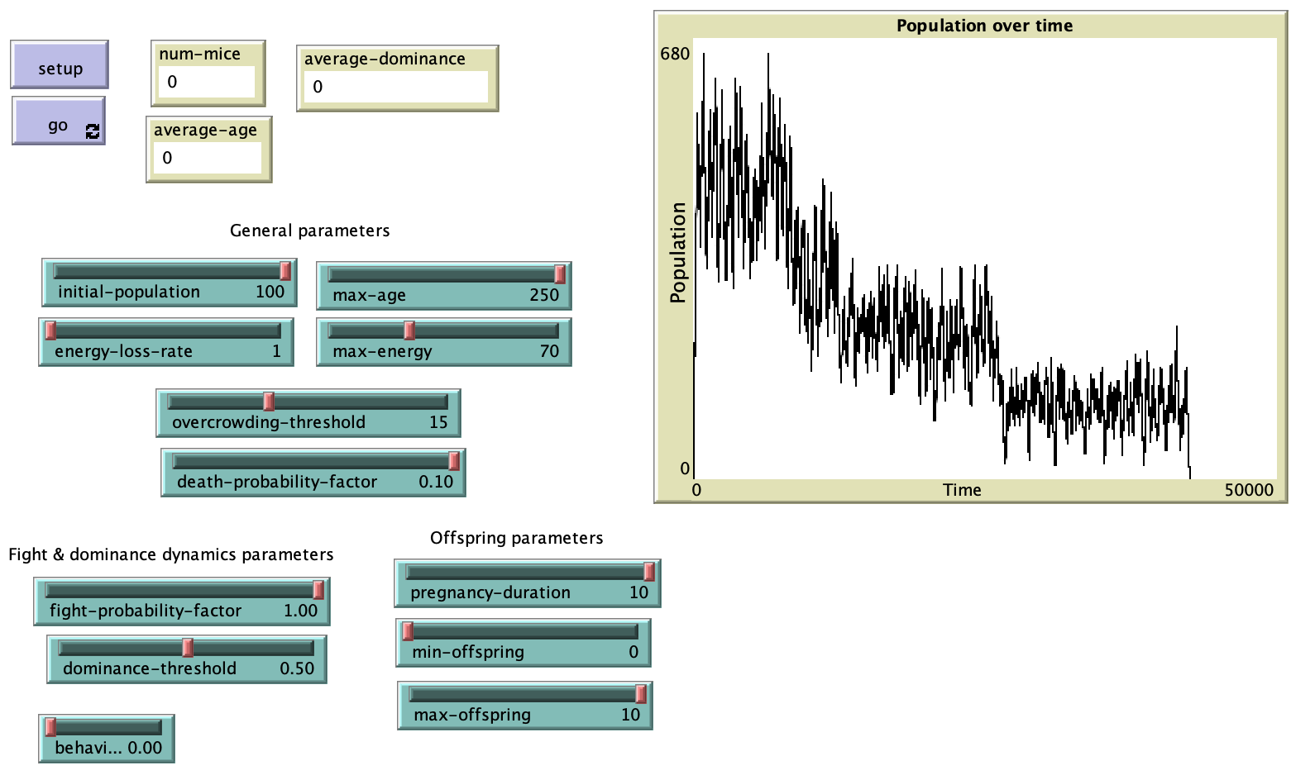
Social dominance and fights – Changing max-age

Slide 27
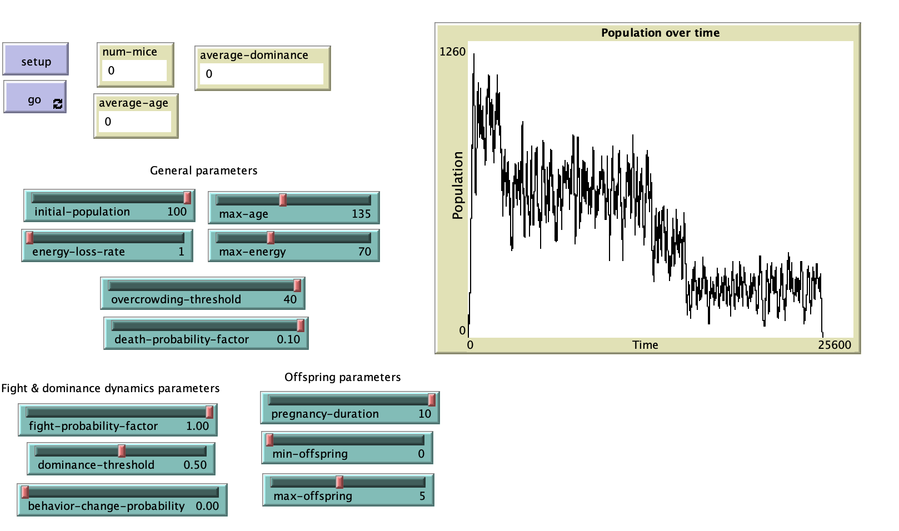
Social dominance and fights – Changing Overcrowding Threshold

Slide 28
3. Infant Mortality and Mothership
Speaker: Francesco Rosano

Slide 29
«… An even greater number (of females - editor’s note), after successfully giving birth, fell short in their maternal functions.
... stress from social interaction led to such disruption of maternal behavior that few young survived.
Population Density and Social Pathology,
John B. Calhoun
https://gwern.net/doc/sociology/1962-calhoun.pdf

Slide 30
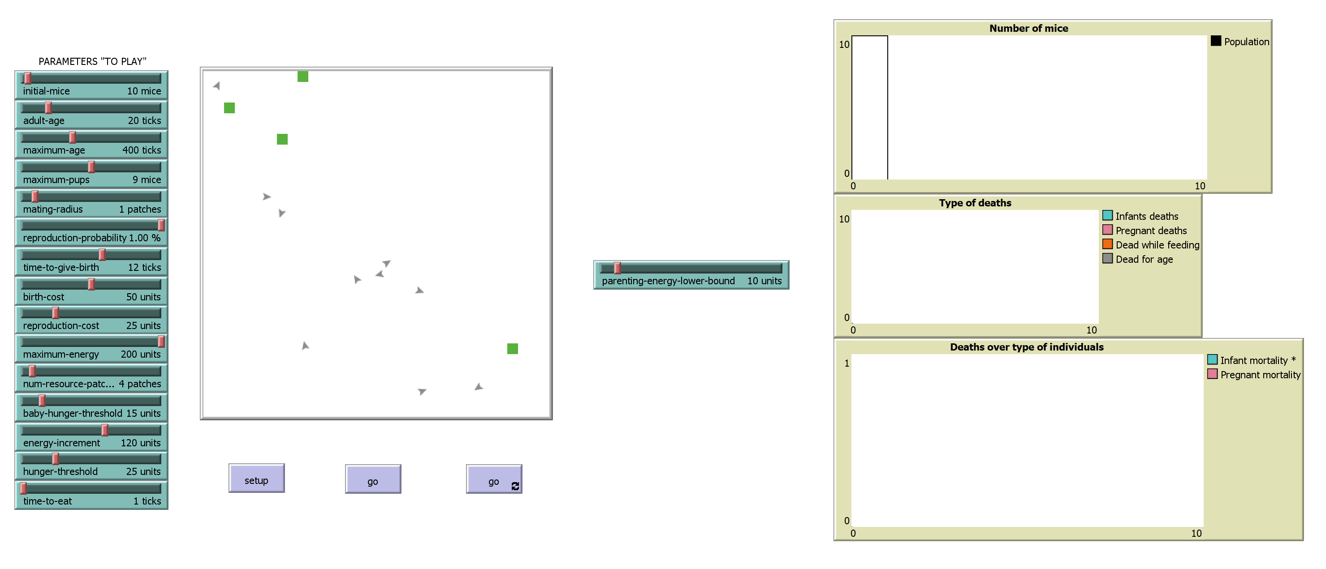
Infant Mortality and Mothership
MODEL RULES:
Finite number of infinite energy sources
Agents move randomly until when they need resources, then towards sources
Time to eat proportional to the number of agents in the radius of the source
Only «adult» mice get pregnant (coupling with another mouse)
Pregnancy takes time
«Young» mice can get fed only by their parents
Notes:
Attributes: Each mouse agent should have attributes such as health, stress level, reproductive status, age, and energy.
Behaviors: Program behaviors that include eating, mating, fighting, nesting, and grooming.
Social Interactions: Define how mice interact with each other—cooperation in nesting, competition for space, or aggression. Reproduction: Set rules for mating and offspring, including the impact of stress and overcrowding on reproductive success. Stress and Health: Incorporate the effects of high density, such as increased stress leading to health decline or altered behaviors (e.g., reduced mating, increased aggression).

Slide 31
Infant Mortality and Mothership
MODEL SETTING:
MAIN PARAMETER
Notes:
Attributes: Each mouse agent should have attributes such as health, stress level, reproductive status, age, and energy.
Behaviors: Program behaviors that include eating, mating, fighting, nesting, and grooming.
Social Interactions: Define how mice interact with each other—cooperation in nesting, competition for space, or aggression. Reproduction: Set rules for mating and offspring, including the impact of stress and overcrowding on reproductive success. Stress and Health: Incorporate the effects of high density, such as increased stress leading to health decline or altered behaviors (e.g., reduced mating, increased aggression).

Slide 32
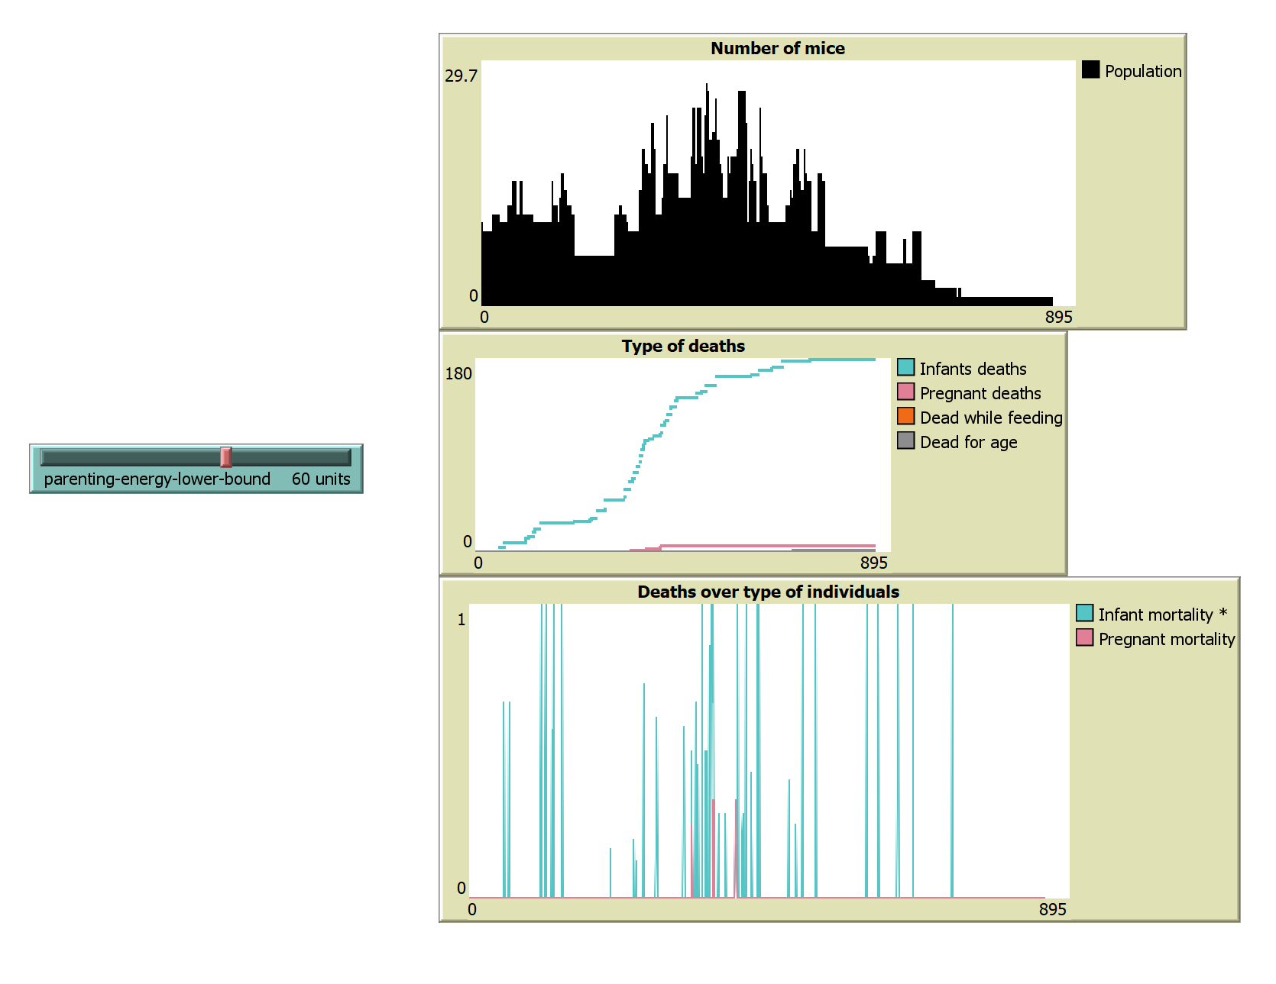
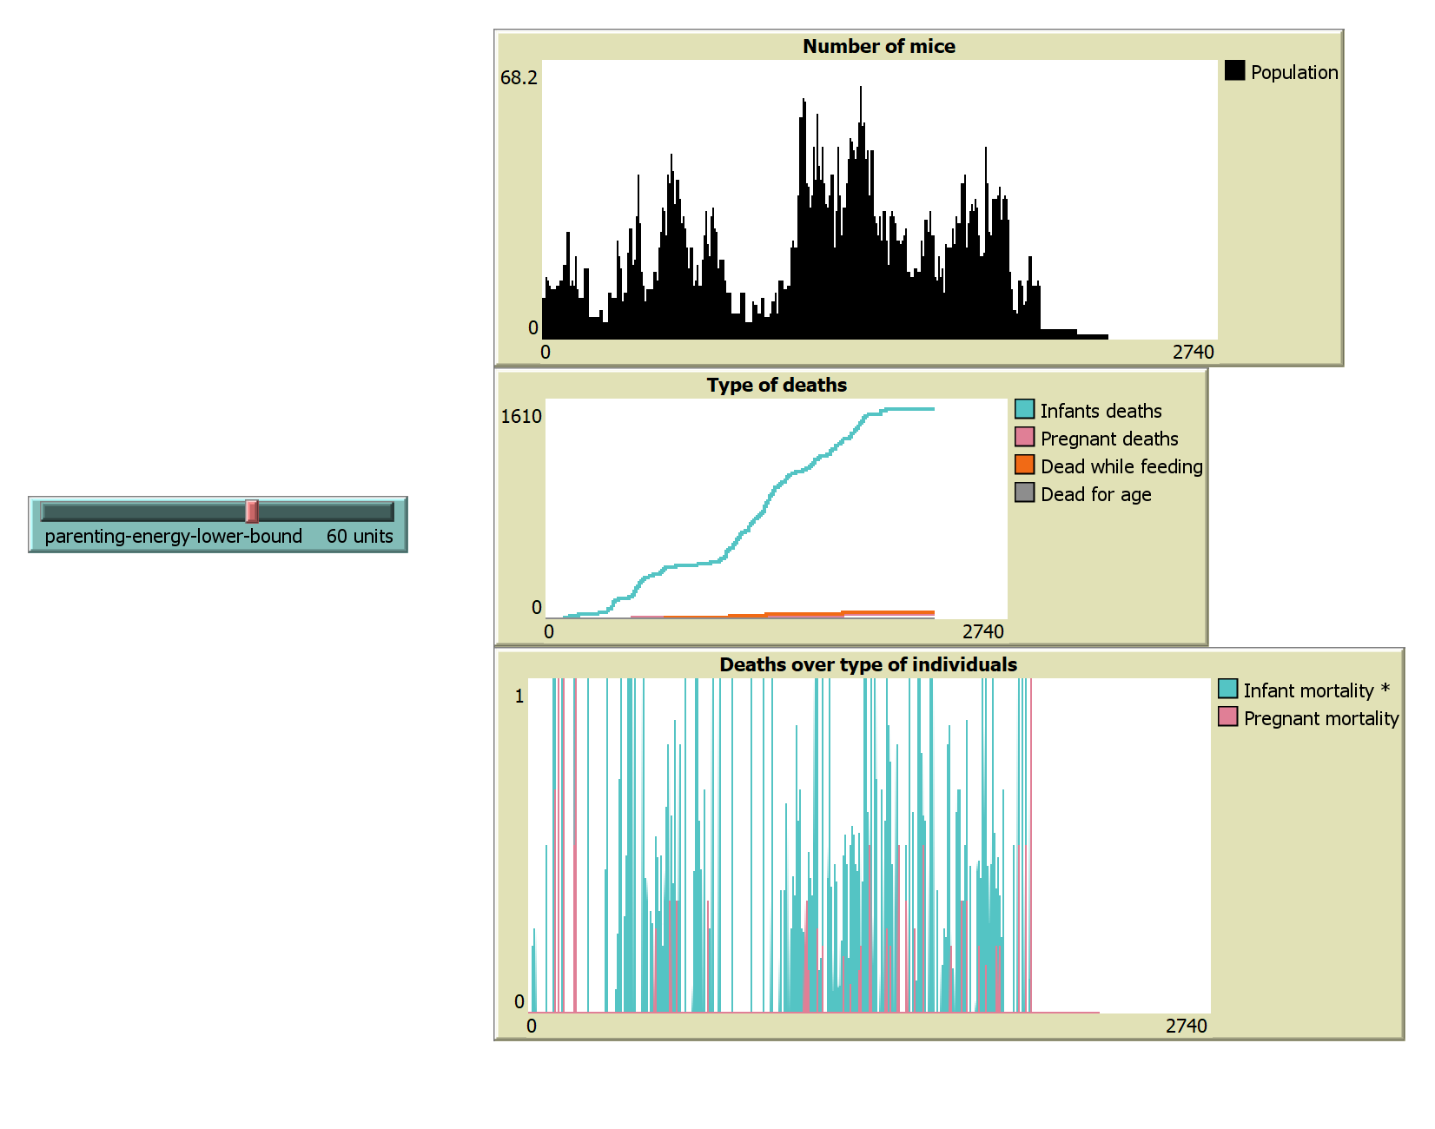
Infant Mortality and Mothership
LOW «MOTHERSHIP» EXTINCTION
VERY LOW PEAKS OF POPULATION
CORRELATION BETWEEN POPULATION PEAKS AND INFANT MORTALITY
Notes:
Attributes: Each mouse agent should have attributes such as health, stress level, reproductive status, age, and energy.
Behaviors: Program behaviors that include eating, mating, fighting, nesting, and grooming.
Social Interactions: Define how mice interact with each other—cooperation in nesting, competition for space, or aggression. Reproduction: Set rules for mating and offspring, including the impact of stress and overcrowding on reproductive success. Stress and Health: Incorporate the effects of high density, such as increased stress leading to health decline or altered behaviors (e.g., reduced mating, increased aggression).

Slide 33
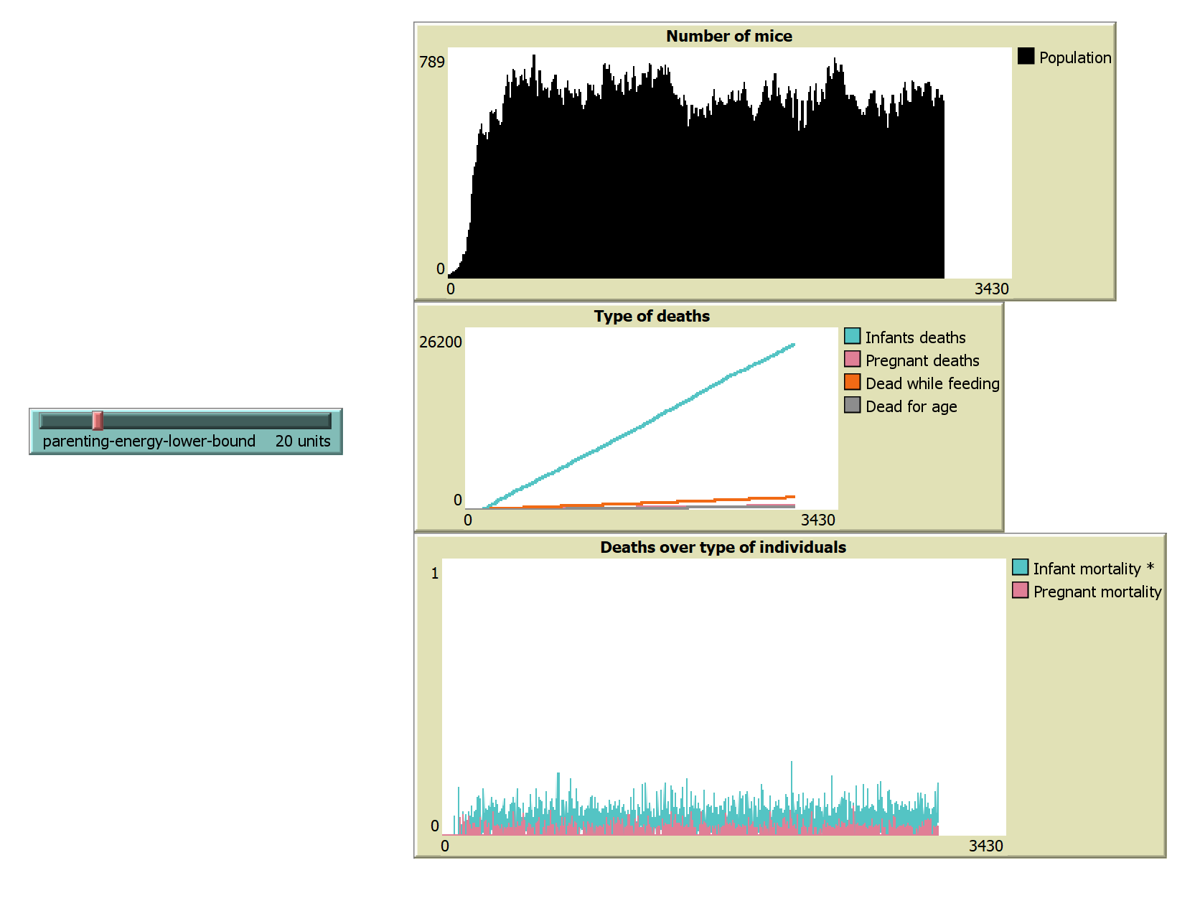
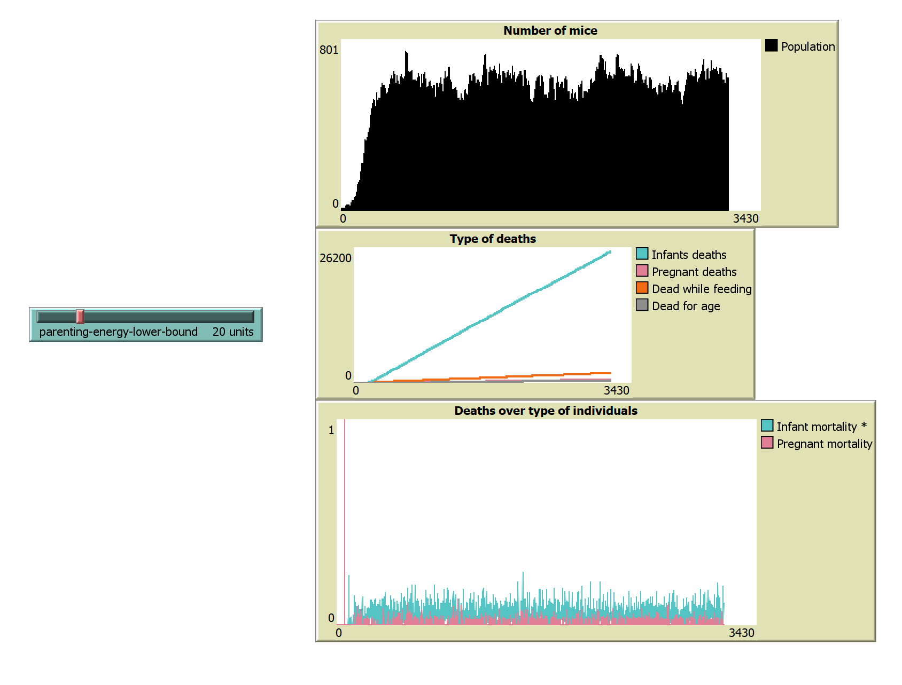
Infant Mortality and Mothership
HIGH «MOTHERSHIP» STABILITY
AVERAGE POPULATION IS WAY HIGHER
INFANT MORTALITY IS STABLE, AND OVERALL LOWER
Notes:
Attributes: Each mouse agent should have attributes such as health, stress level, reproductive status, age, and energy.
Behaviors: Program behaviors that include eating, mating, fighting, nesting, and grooming.
Social Interactions: Define how mice interact with each other—cooperation in nesting, competition for space, or aggression. Reproduction: Set rules for mating and offspring, including the impact of stress and overcrowding on reproductive success. Stress and Health: Incorporate the effects of high density, such as increased stress leading to health decline or altered behaviors (e.g., reduced mating, increased aggression).

Slide 34
Thank you for your attention!
A. Melone, H. Ranieri, F. Rosano

